Slide 2
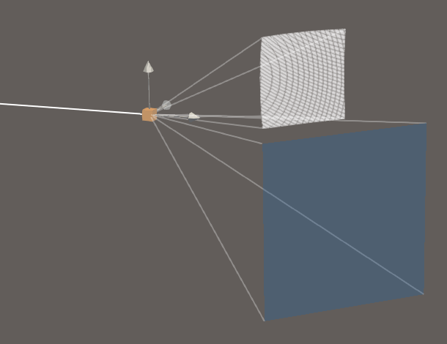

Slide 3
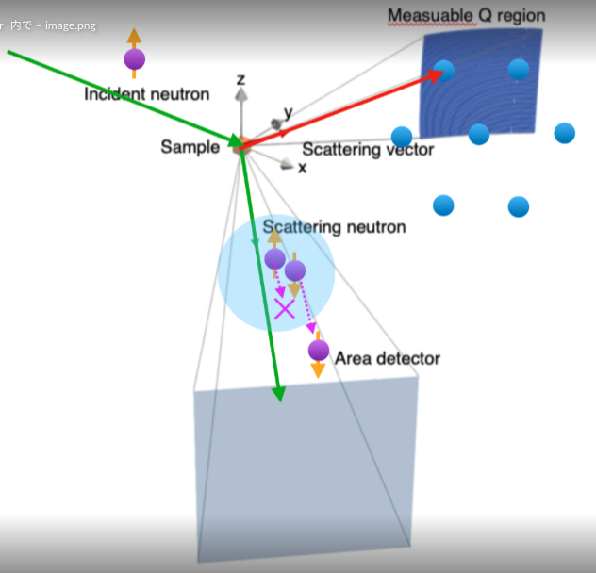

Slide 4
Measuable Q region
Incident neutron
z
y
Sample
Scattering vector
x
Scattering neutron
Area detector

Slide 5





z
$k_{i}$(in-plane)
$Q_{2}$(out-of-plane)
y
$Q_{1}$(in-plane)
Nuclear reflection
Magnetic reflections
$k_{f1}$(in-plane)
Spin analyzer acceptance
$k_{f2}$(out-of-plane)
x

Slide 6
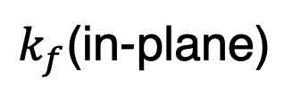
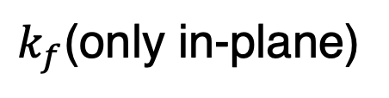
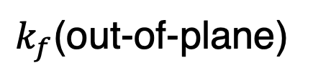
(a)
(b)
Sample
Neutron spin
Cu₂MnAl
³He-NSF
↑↓
↑
↑↓
$k_{f}$(only in-plane)
$k_{f}$(in-plane)
↑
$k_{f}$(out-of-plane)
to point detector
2D detector

Slide 7
(a)
(b)
Sample
Neutron spin
Cu₂MnAl
³He-NSF
↑↓
↑
↑↓
$k_{f}$(only in-plane)
$k_{f}$(in-plane)
↑
$k_{f}$(out-of-plane)
to point detector
2D detector

Slide 8

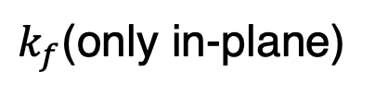


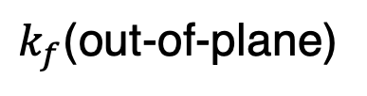
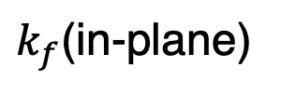
(a)
Cu₂MnAl (Polarizer)
Spin flipper off : ↑ on : ↓
Incident neutrons
Cu₂MnAl (Analyzer)
↑↓
↑
Sample
↑↓
Neutron spin
$$k_{i}$$
↑
$$Q$$
$k_{f}$(only in-plane)
point detector
(b)
³He-NSF (³He polarity can be flipped)
↑
↑↓
↑
↑↓
$k_{f}$(in-plane)
$$Q$$
$k_{f}$(out-of-plane)
2D detector

Slide 9
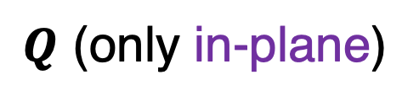
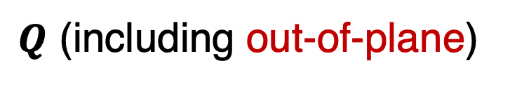
(a)
Cu₂MnAl (Polarizer)
Incident neutrons
Sample
Cu₂MnAl (Analyzer)
↑↓
↑
↑↓
Neutron spin
Spin flipper off : ↑ on : ↓
↑
$Q$ (only in-plane)
point detector
(b)
³He-NSF (Analyzer)
↑
↑↓
↑
↑↓
$Q$ (including out-of-plane)
2D detector

Slide 10
(a)
Cu₂MnAl (Polarizer)
Cu₂MnAl (Analyzer)
↑↓
↑
Sample
Incident neutrons
↑↓
↑
Neutron spin
Spin flipper off : ↑ on : ↓
point detector
$Q$ (only in-plane)
(b)
³He-NSF (Analyzer)
↑
↑↓
↑
↑↓
$Q$ (including out-of-plane)
2D detector

Slide 11
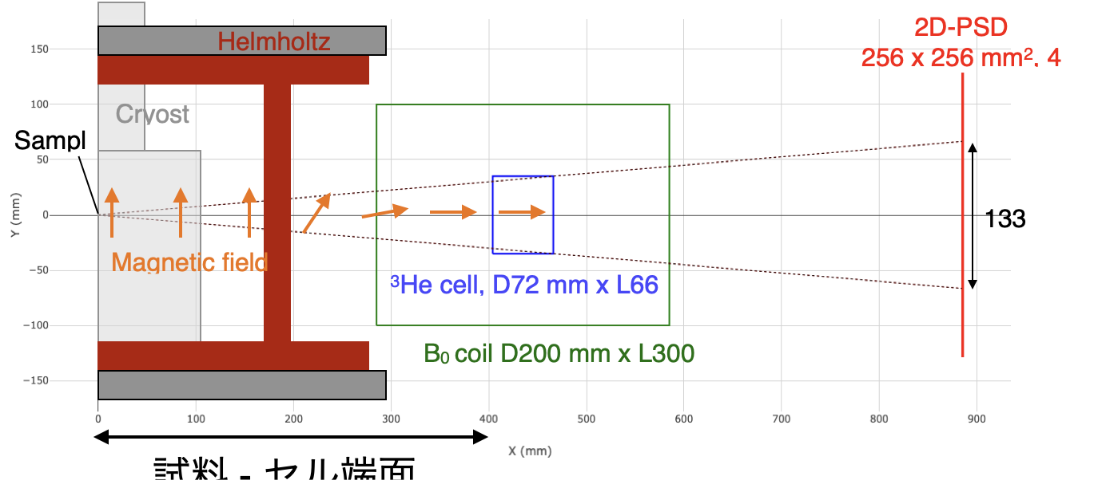

Slide 12
ω rotation
Helmholtz coil
Cryostat
Neutron Area detector
³He NSF coil
Neutron guide tube
Polarization analysis region
Magnetic field direction
RF coil
³He cell
Neutron beam path
Sample
Pickup coil

Slide 13
ω rotation
Helmholtz coil
Cryostat
Neutron Area detector
³He NSF coil
Neutron guide tube
Polarization analysis region
Magnetic field direction
RF coil
³He cell
Neutron beam path
Sample
Pickup coil

Slide 14
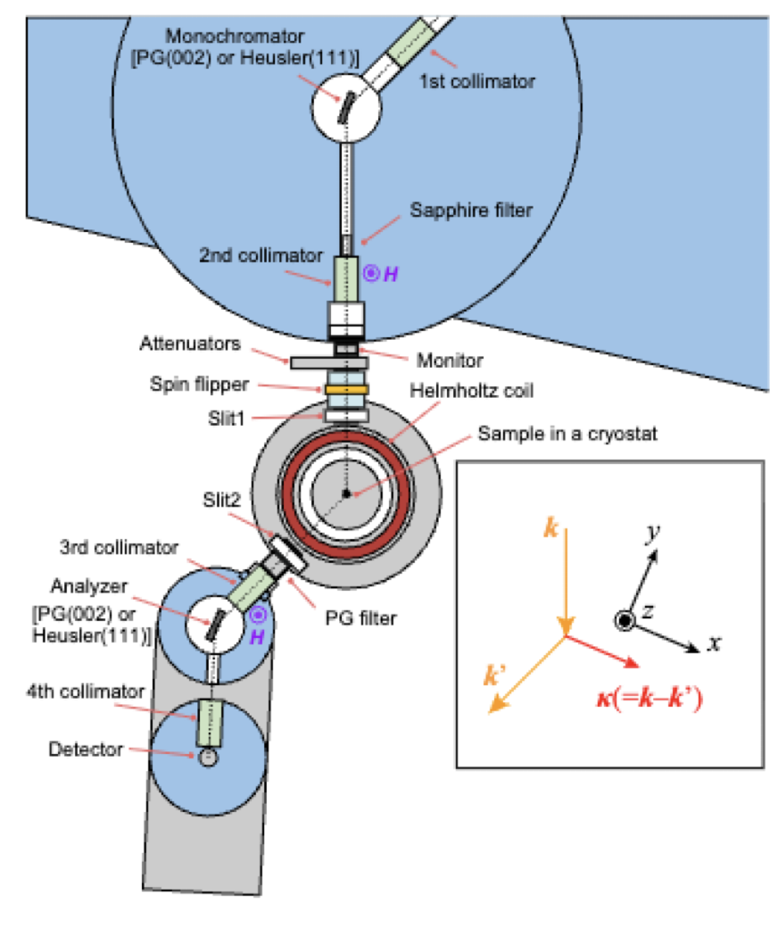
Beam stopper
Beam stopper

Slide 15
Incident neutron beam (polarized by Cu₂MnAl crystal)
Top view
Sample
Top view
Beam stopper
Neutron Area detector
³He NSF coil
RF coil
Polarization analysis region
Sample
³He cell
Incident neutron (polarized by Cu₂MnAl)
Neutron guide tube
Side view
ω rotation
Helmholtz coil
Cryostat
Magnetic field direction
Pickup coil

Slide 16


Incident neutron beam (polarized by Cu₂MnAl crystal)
Top view
Top view
Beam stopper
Sample
2D detecter
$$c^{∗}$$
$$a^{∗}$$
Sample
32°
³He cell
Neutron guide tube
Incident neutron
RF coil
³He NSF coil
Side view
ω rotation
Helmholtz coil
Refrigerator
±4.0°
Magnetic field direction
Pickup coil
0.430 m
0.915 m

Slide 17
Neutron Area detector
³He NSF coil
Neutron guide tube
Polarization analysis region
RF coil
³He cell

Slide 18
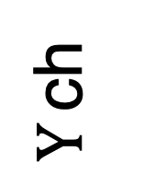
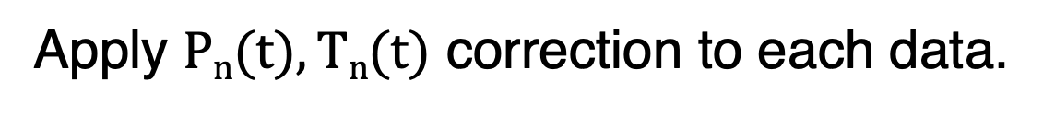
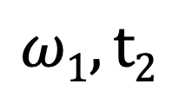
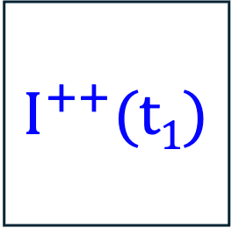
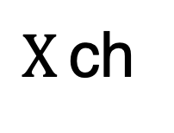

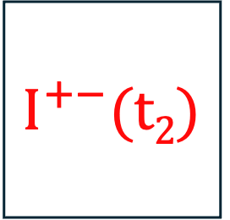
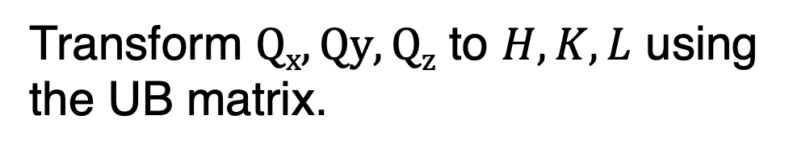
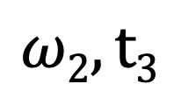
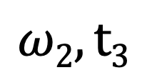

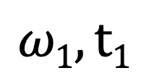
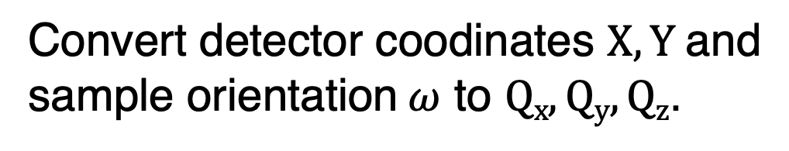
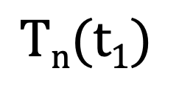
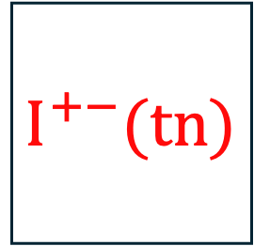
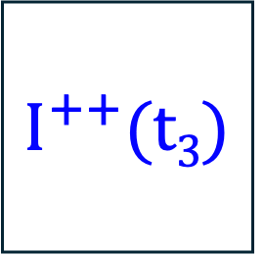
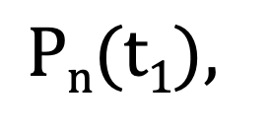
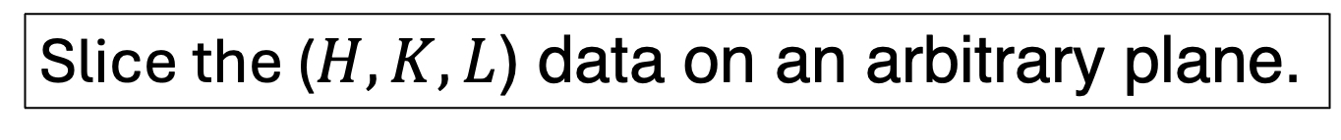
Data set
$$ω1, t1$$
$$ω1, t2$$
$$ω2, t3$$
$$ω2, t3$$
$$I^{++}(t1)$$
$$I^{+−}(t2)$$
$$I^{++}(t3)$$
$$I^{+−}(tn)$$
$Y$ ch
...
$X$ ch
$$Pn(t1),$$
$$Pn(tn)$$
$$Tn(t1)$$
$$Tn(tn)$$
Apply $Pn(t), Tn(t)$ correction to each data.
Convert detector coodinates $X, Y$and sample orientation $ω$ to $Qx, Qy, Qz$.
Transform $Qx, Qy, Qz$ to $H, K, L$ using the UB matrix.
Slice the ($H,K,L$) data on an arbitrary plane.

Slide 19
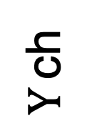
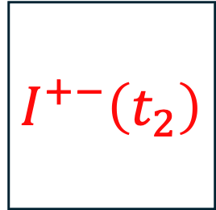
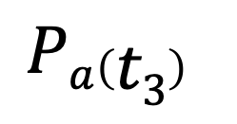
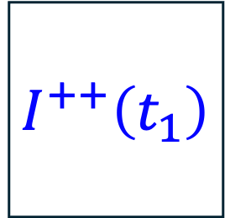
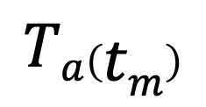
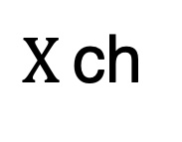
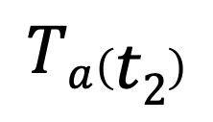


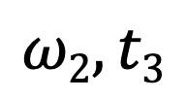
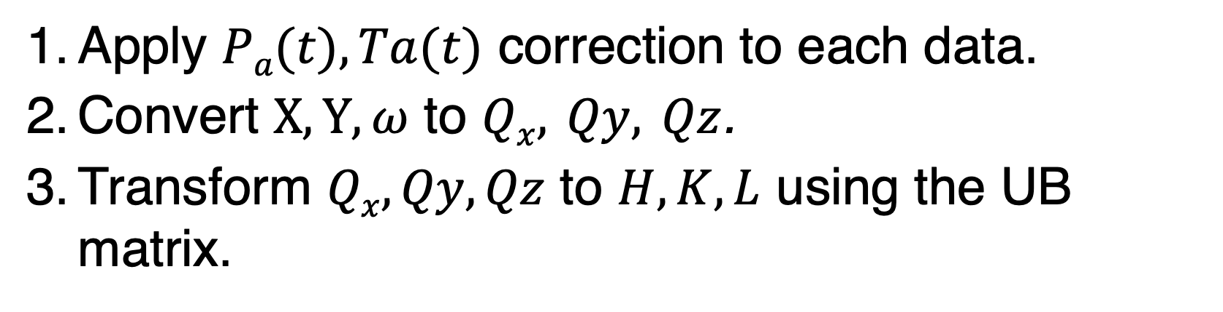
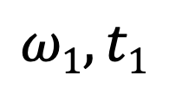
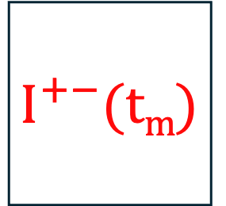

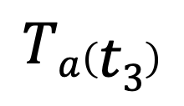
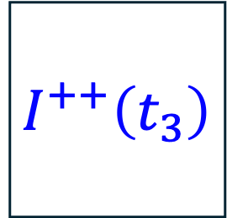
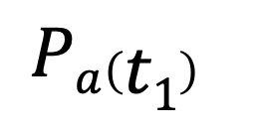
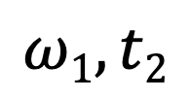

Data Set
$$ω1, t1$$
$$ω1, t2$$
$$ω2, t3$$
$$ωn, tm$$
$$I^{++}\left(t_{1}\right)$$
$$I^{+−}\left(t_{2}\right)$$
$$I^{++}\left(t_{3}\right)$$
$$I^{+−}(tm)$$
$Y$ ch
...
$X$ ch
$$Pa\left(t1\right)$$
$$Pa\left(t2\right)$$
$$Pa\left(t3\right)$$
...
$$Pa\left(tm\right)$$
$$Ta\left(t1\right)$$
$$Ta\left(t2\right)$$
$$Ta\left(t3\right)$$
$$Ta\left(tm\right)$$
Data Analysis
Apply $Pa(t), Ta(t)$ correction to each data.
Convert $X, Y, ω$ to $Qx, Qy, Qz$.
Transform $Qx, Qy, Qz$ to $H, K, L$ using the UB matrix.
Slice the ($H,K,L$) data on an arbitrary plane.

Slide 20
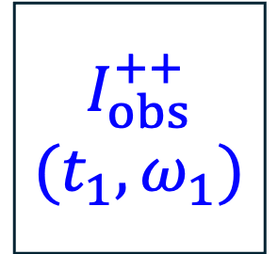
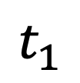
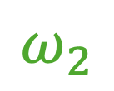
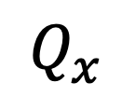

























³He spin flip (AFP-NMR)
$$Q_{z}$$
flip
flip
$$n$$
$$I_{obs}^{++}$$
$$(t_{1},ω_{1})$$
$$I_{obs}^{++}$$
$$(t_{3},ω_{2})$$
$Y$ ch
$$1$$
$$I_{corr}^{++}$$
$$Q_{y}$$
$X$ ch
$$Q_{x}$$
$$I_{obs}^{+−}$$
$$\left(t_{2},ω_{1}\right)$$
$$I_{obs}^{+−}$$
$$\left(t_{4},ω_{2}\right)$$
Time Dependent Correction
Map to Reciprocal Space
$$I_{corr}^{++}\left(ω_{n}\right)$$
$$I_{corr}^{+−}\left(Q_{x}, Q_{y}, Q_{z}\right)$$
$$n$$
$$Q_{z}$$
$$P_{a}(t)$$
$$P_{a},T_{a}$$
$$1$$
$$I_{corr}^{+−}$$
$$Q_{y}$$
$$T_{a}(t)$$
$$Q_{x}$$
$$t_{1}$$
$$t_{2}$$
$$t_{3}$$
$$t_{4}$$
Time
$$ω_{1}$$
$$ω_{2}$$
$$I_{corr}^{+−} \left(ω_{n}\right)$$
$$I_{corr}^{+−}\left(Q_{x}, Q_{y}, Q_{z}\right)$$

Slide 21
















³He spin flip (AFP-NMR)
flip
flip
$$n$$
$$Q_{z}$$
Magnetic reflections
$$I_{obs}^{++}(t_{1},$$
$$ω_{1},x_{i}, y_{j})$$
$$I_{obs}^{++}(t_{3},$$
$$ω_{2},x_{i}, y_{j})$$
$Y$ ch
$$1$$
$$I^{++}(ω_{1},$$
$$x_{i}, y_{j})$$
$$Q_{y}$$
$X$ ch
$$I_{obs}^{+−}(t_{2},$$
$$ω_{1},x_{i}, y_{j})$$
$$I_{obs}^{+−}(t_{4},$$
$$ω_{2},x_{i}, y_{j})$$
$$Q_{x}$$
Time Dependent Correction
Map to Reciprocal Space
$$I^{++}\left(ω_{n},x_{i},y_{j}\right)$$
$$I^{++}\left(Q_{x}, Q_{y}, Q_{z}\right)$$
$$n$$
$$Q_{z}$$
$$P_{a}(t)$$
$$P_{a},T_{a}$$
$$1$$
$$I^{+−}(ω_{1},$$
$$x_{i}, y_{j})$$
$$Q_{y}$$
$$T_{a}(t)$$
$$Q_{x}$$
$$t_{1}$$
$$t_{2}$$
$$t_{3}$$
$$t_{4}$$
Time
$$ω_{1}$$
$$ω_{2}$$
$$I^{+−}\left(ω_{n},x_{i},y_{j}\right)$$
$$I^{+−}\left(Q_{x}, Q_{y}, Q_{z}\right)$$

Slide 22
Neutron polarization
³He polarization
Neutron transmission

Slide 23
Neutron polarization
Neutron polarization
³He polarization
³He polarization
Neutron transmission
Neutron transmission

Slide 24
Neutron polarization
³He polarization
Neutron transmission

Slide 26


















$$×Σ^{++}$$
$$×T_{a}^{+}p_{a}^{+}$$
$$N_{+}T_{p}^{+}p_{p}^{+}Σ^{++}T_{a}^{+}p_{a}^{+}$$
$$N_{+}$$
$$×T_{p}^{}p_{p}^{}$$
$$×Σ^{+−}$$
$$×T_{a}^{+}{(1−p}_{a}^{+})$$
$$N_{+}T_{p}^{+}p_{p}^{+}Σ^{+−}T_{a}^{+}(1−p_{a}^{+})$$
$$I^{++}$$
$$×Σ^{−+}$$
$$×T_{a}^{+}p_{a}^{+}$$
$$N_{−}T_{p}^{+}{(1−p}_{p}^{+})Σ^{−+}T_{a}^{+}p_{a}^{+}$$
$$N_{−}$$
$$×T_{p}^{+}{(1−p}_{p}^{+})$$
$$×Σ^{−−}$$
$$×T_{a}^{+}{(1−p}_{a}^{+})$$
$$N_{−}T_{p}^{+}{(1−p}_{p}^{+})Σ^{−−}T_{a}^{+}(1−p_{a}^{+})$$
Polarizer Cu₂MnAl +
Sample
Analyzer ex-situ ³He-NSF + (or $−$)
Detector

Slide 27












$$×Σ^{++}$$
$$×T_{a}p_{a}$$
$$N_{0}T_{p}p_{p}Σ^{++}T_{a}p_{a}$$
$$×T_{p}p_{p}$$
$$×Σ^{+−}$$
$$×T_{a}{(1−p}_{a})$$
$$N_{0}T_{p}p_{p}Σ^{+−}T_{a} (1−p_{a})$$
$$N_{0}$$
$$I^{++}$$
$$×Σ^{−+}$$
$$×T_{a}p_{a}$$
$$N_{0}T_{p}\left(1−p_{p}\right)Σ^{−+}T_{a}p_{a}$$
$$×T_{p}(1−p_{p})$$
$$×Σ^{−−}$$
$$×T_{a}{(1−p}_{a})$$
$$N_{0}T_{p}\left(1−p_{p}\right)Σ^{−−}T_{a} (1−p_{a})$$
Polarizer Cu₂MnAl +
Sample
Analyzer ex-situ ³He-NSF + (or $−$)
Detector

Slide 28












$$×I^{++}$$
$$×T_{a}p_{a}$$
$$×T_{p}p_{p}$$
$$×I^{+−}$$
$$×T_{a}{(1−p}_{a})$$
$$N_{0}$$
$$I_{obs}^{++}$$
$$×I^{−+}$$
$$×T_{a}p_{a}$$
$$×T_{p}(1−p_{p})$$
$$×I^{−−}$$
$$×T_{a}{(1−p}_{a})$$
Polarizer Heusler +
Sample
Analyzer ex-situ ³He-NSF +
Detector

Slide 29













$$×I^{++}$$
$$×{2T}_{a}p_{a}^{+}$$
$$N^{+}$$
$$×2T_{p}p_{p}^{+}$$
$$×I^{+−}$$
$$×{2T}_{a}(1−p_{a}^{+})$$
$$I_{obs}^{++}$$
$$×I^{−+}$$
$$×{2T}_{a}p_{a}^{+}$$
$$N^{−}$$
$$×{2T}_{p}(1−p_{p}^{+})$$
$$×I^{−−}$$
$$×2T_{a}(1−p_{a}^{+})$$
Polarizer Heusler +
Sample
Analyzer ex-situ ³He-NSF +
Detector

Slide 30






$$×I^{++}$$
$$×{2T}_{a}p_{a}$$
$$N^{+}$$
$$×2T_{p}p_{a}$$
$$×I^{+−}$$
$$×{2T}_{a}(1−p_{a})$$
$$I_{obs}^{++}$$
$$×I^{−+}$$
$$×{2T}_{a}p_{a}$$
$$N^{−}$$
$$×{2T}_{p}(1−p_{a})$$
$$×I^{−−}$$
$$×2T_{a}(1−p_{a})$$
Polarizer Heusler +
Sample
Analyzer ex-situ ³He-NSF +
Detector

Slide 31








$$×I^{++}$$
$$×T_{a}(1+P_{a})$$
$$N_{+}$$
$$×T_{p}(1+P_{p})$$
$$×I^{+−}$$
$$×T_{a}{(1−P}_{a})$$
$$I_{obs}^{++}$$
$$×I^{−+}$$
$$×T_{a}(1+P_{a})$$
$$N_{−}$$
$$×T_{p}(1−P_{p})$$
$$×I^{−−}$$
$$×T_{a}{(1−P}_{a})$$
Polarizer Heusler +
Sample
Analyzer ex-situ ³He-NSF +
Detector

Slide 32








$$×I^{++}$$
$$×T_{p}^{+}$$
$$N^{+}$$
$$×T_{p}^{+}$$
$$×I^{+−}$$
$$×T_{p}^{−}$$
$$I_{obs}^{++}$$
$$×I^{−+}$$
$$×T_{p}^{+}$$
$$N^{−}$$
$$×T_{p}^{−}$$
$$×I^{−−}$$
$$×T_{p}^{−}$$
Polarizer Heusler +
Sample
Analyzer ex-situ ³He-NSF +
Detector

Slide 34
1Å
3Å
(a)
(b) #Frame2-3
Sample position from spallation source
Collinear structure
Frame
#1
#2
#3
#4
#5
#6
#7
Phase transition field
(c) #Frame5-6
Magnetic field of long pulse magnet
Non-collinear structure
Kicker signal

Slide 36

Sliced plane (a)
Measured Q region
Sliced plane (b)
Reciprocal lattice points

Slide 37



Reciprocal lattice points
Two-dimensional detector
Measurable Q region
Sample
$$k_{f}$$
$$Q$$
Polarization analysis region
³He neutron spin filter (Spin analyzer)
$$k_{i}$$
Incident polarized neutron

Slide 38
(a) Unpolarized
(b) Polarized
Intensity (a.u.)
Intensity (a.u.)

Slide 39
(c) Unpolarized
(d) Polarized
(e) Line cut
(e)
(f) Line cut
(f)

Slide 40
Sliced plane (a)
Measured Q region
Sliced plane (b)
Intensity (a.u.)
Reciprocal lattice points

Slide 42


Intensity (a.u.)
Intensity (a.u.)

Slide 43
(a) Raw data
(b) Corrected data

Slide 44
(a) Raw data
(b) Corrected data

Slide 45


(a) Raw data
(b) Corrected data
$$ℐ_{obs}^{++}$$
$$ℐ_{obs}^{+−}$$
(H,0,2) (r.l.u.)

Slide 46


(a) Non-spin flip ($I^{++}$)
(b) Spin flip ($I^{+−}$)
(c)

Slide 47


(a) Non-spin flip ($I^{++}$)
(b) Spin flip ($I^{+−}$)
(c) X-direction line profile (dased region in (a), (b))
Integrated intensity (y pixels 27-35) (a.u.)

Slide 48
(a)
(b)
(c)
Integrated intensity (y pixels 27-35) (a.u.)

Slide 49

(a)
(b)
(c)
Integrated intensity (y pixels 27-35) (a.u.)

Slide 50



(a) $\overline{1}02$ reflection in $I_{obs}^{++}$
(b) $\overline{1}02$ reflection in $I_{obs}^{+−}$
(c) X projection of the dashed line region in (a) and (b))

Slide 51


(a) $\overline{1}02$ reflection in $I_{obs}^{++}$
(b) $\overline{1}02$ reflection in $I_{obs}^{+−}$
(c) X projection of the dashed line region in (a) and (b))

Slide 52
(a) $\overline{1}02$ reflection in $I_{obs}^{++}$
(b) $\overline{1}02$ reflection in $I_{obs}^{+−}$
(c) X projection of the dashed line region in (a) and (b))

Slide 53


(a) $I_{obs}^{++}$ map
(b) $I_{obs}^{+−}$ map
(d) X projection of the dashed line region in (a) and (b))

Slide 54







(0,-K+2K,0) || z
Sliced Region (b),(d)
Sliced Region (c),(e)
$$H=\overline{1}$$
(-H,0,0) || -x
$$q_{3}$$
$$q_{1}$$
$$\overline{1}02$$
$$L=1.5$$
$$q_{2}$$
(0,0,L) || y

Slide 55





(0,-H+2K,0) || z
(c),(e)
(b),(d)
(-H-K/2,0,0) || -x
$$q_{3}$$
$$q_{1}$$
$$\overline{1}02$$
$$L=1.5$$
$$q_{2}$$
(0,0,L) || y

Slide 56





(c)
(f)
(a)
(f)
(-K/2,K,0) || z
(g)
(c),(e)
(b),(d)
(-H,0,0) || -x
$$q_{3}$$
(g)
$$q_{1}$$
(e)
$$\overline{1}02$$
$$L=1.5$$
$$q_{2}$$
(0,0,L) || y

Slide 57








(a)
(b)
(-K/2,K,0) || z
(c)
(b)
$$q_{1}$$
$$q_{3}$$
(-H,0,0) || -x
$$q_{1}$$
$$q_{3}$$
(c)
$$\overline{1}02$$
$$q_{3}$$
$$q_{2}$$
$$q_{1}$$
$$L=1.5$$
(0,0,L) || y
$$q_{2}$$

Slide 58






(a)
(b)
(c)
(f)
(-K/2,K,0) || z
$$q_{3}$$
$$q_{1}$$
(b), (c)
$$q_{2}$$
(d), (e)
(-H,0,0) || -x
$$q_{3}$$
$$q_{1}$$
(d)
(e)
(g)
(f)
$$\overline{1}02$$
(g)
$$q_{2}$$
(0,0,L) || y
$$q_{3}$$
$$q_{1}$$

Slide 59





(a)
(b)
(c)
(f)
(-K/2,K,0) || z
$$q_{3}$$
$$q_{1}$$
(b), (c)
$$q_{2}$$
(d), (e)
(-H,0,0) || -x
$$q_{3}$$
$$q_{1}$$
(d)
(e)
(g)
(f)
$$\overline{1}02$$
(g)
$$q_{2}$$
(0,0,L) || y
$$q_{1}$$
$$q_{3}, q_{2}$$

Slide 60






(a)
(b)
(c)
(f)
(K/2,-K,0) || z
$$q_{3}$$
$$q_{1}$$
(f)
(b), (c)
(-K/2, K, 1.5) (r.l.u.)
(-K/2, K, 1.5) (r.l.u.)
(g)
Intensity (arb.unit)
(d), (e)
(-H,0,0) || -x
$$q_{2}$$
$$q_{2}$$
$$q_{1}$$
(H,0,1.5) (r.l.u.)
(H,0,1.5) (r.l.u.)
(H,0,1.5) (r.l.u.)
(d)
(e)
(g)
$$\overline{1}02$$
(g)
$$q_{3}$$
(0,0,L) (r.l.u.)
$$q_{3}, q_{2}$$
L (r.l.u.)
$$q_{1}$$
Intensity (arb.unit)
(0,0,L) || y
(f)
(H,0,0) (r.l.u.)
(H,0,0) (r.l.u.)
(H,0,1.5) (r.l.u.)

Slide 61





(a)
(b)
(c)
(f)
(K/2,-K,0) || z
$$q_{3}$$
(f)
(b), (c)
(-K/2, K, 1.5) (r.l.u.)
(-K/2, K, 1.5) (r.l.u.)
(g)
Intensity (arb.unit)
$$q_{1}$$
(d), (e)
$$q_{2}$$
(-H,0,0) || -x
$$q_{2}$$
$$q_{1}$$
(H,0,1.5) (r.l.u.)
(H,0,1.5) (r.l.u.)
(H,0,1.5) (r.l.u.)
(d)
(e)
(g)
$$\overline{1}02$$
a*
c*
(g)
$$q_{3}$$
(0,0,L) (r.l.u.)
$$q_{3}, q_{2}$$
(0,0,L) (r.l.u.)
b*
$$q_{1}$$
Intensity (arb.unit)
(0,0,L) || y
(f)
(H,0,0) (r.l.u.)
(H,0,0) (r.l.u.)
(H,0,1.5) (r.l.u.)

Slide 62




(a)
(b)
(c)
(f)
(K/2,-K,0) || z
$$q_{3}$$
(f)
(-K/2, K, 1.5) (r.l.u.)
Intensity (arb.unit)
(b), (c)
(-K/2, K, 1.5) (r.l.u.)
$I^{++}−I^{+−}$ (arb.unit)
$$q_{1}$$
(g)
Intensity (arb.unit)
(d), (e)
$$q_{2}$$
(-H,0,0) || -x
$$q_{2}$$
$$q_{1}$$
(H,0,1.5) (r.l.u.)
(H,0,1.5) (r.l.u.)
(H ${−δ}_{1}/2$,$δ_{1}$,1.5) (r.l.u.)
(d)
(e)
(g)
$$\overline{1}02$$
a*
c*
(g)
$$q_{3}$$
(0,0,L) (r.l.u.)
$$q_{3}, q_{2}$$
b*
$$q_{1}$$
(0,0,L) (r.l.u.)
Intensity (arb.unit)
Intensity (arb.unit)
$I^{++}−I^{+−}$ (arb.unit)
(0,0,L) || y
(f)
(H,0,0) (r.l.u.)
(H,0,0) (r.l.u.)
(H ${−δ}_{2}/2$,$δ_{2}$,1.5) (r.l.u.)

Slide 63


Unpol
$$q_{3}$$
$$q_{1}$$
$$q_{2}$$

Slide 66

ω stage for sample
Sample + cryostat
Helmholtz coil
³He-NSF
Analyzing aperture
ω stage for ³He-NSF

Slide 67
ω stage for sample
Sample + cryostat
Helmholtz coil
³He-NSF
Analyzing aperture
ω stage for ³He-NSF

Slide 68
(a)
(b)
ω stage for sample
Sample + cryostat
Helmholtz coil
³He-NSF
Analyzing aperture
ω stage for ³He-NSF

Slide 69


Slide 70


磁場中での中性子スピンの時間発展 →ブロッホ方程式
$$\frac{dM}{dt}=γM×B$$
M : 中性子の磁気モーメント, γ : 中性子の磁気回転比,
B : 中性子が通過するパス上の磁場.
X軸 : 水平
Y軸：鉛直方向
Z軸：中性子進行方向
1 mTをZ軸方向へ印加しているパス上を初期位相σ_{x},σ_{z}=0, σ_{y}=1の中性子が通過するときの各位置でのスピン状態

